Slide 1



REVA HACK 2022</>
INNOVATE FOR A BETTER TOMORROW!
CYBER LORDS
Ankit Kumar
Abhay Pratap Singh
Jithin J
Nithish R
48 Hours Hybrid International Hackathon
11th Nov - 13 th Nov
Venue: REVA University, Bengaluru

Slide 2

02
REVA HACK 2022 </>
Page
PROBLEM STATEMENT
ACCIDENT ALERT SYSTEM
When an individual riding his/her vehicle, meets with a mishap, quite possibly the individual may experience the ill effects of genuine damage or lapse immediately and there is nobody around to help him & in emergency condition, each and every second is important in saving human’s life. Well, this project is an answer to the issue.

Slide 3

03
Page
REVA HACK 2022 </>
SOLUTION
The model acts as an accident avoidance and detection system that gathers all the information and calls the ambulance and also its provides an ALERT message if you enter into an accidental zone and app suggests nearby accidental zone while travelling, Our application gives statistical report based on accidents occured in a month and if user enters into a false ALARM/Detection then our app provides 1/2 minute to cancel. Our model is safe and reliable.

Slide 4






04
Page
REVA HACK 2022 </>
FEATURES
Contacts Ambulance Immediately
Alternate Options If Ambulance Not Available
Privacy
Secure & Simple
Cancellation Time if any False Alarm Occurs
InApp Alarm When Accident Occurs
Track your Vehicle using
GPS

Slide 5
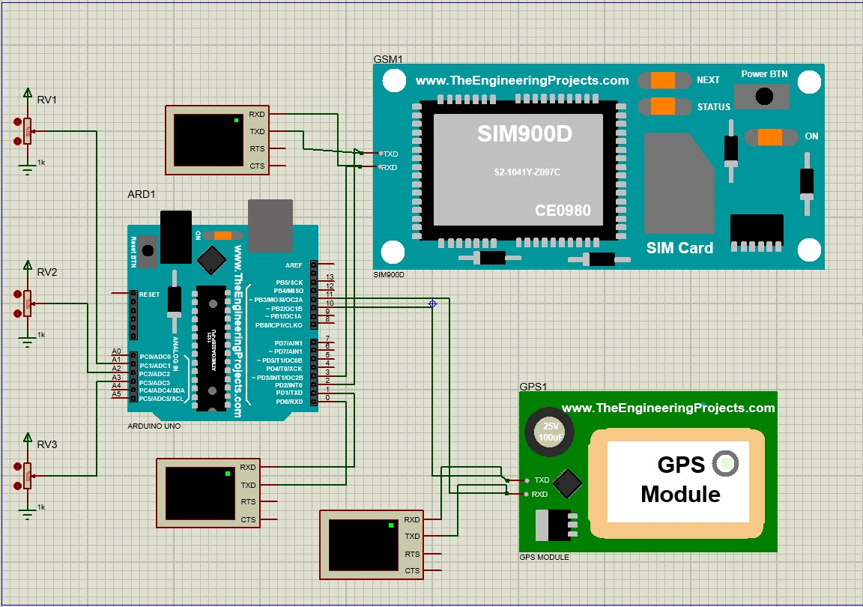
05
Page
REVA HACK 2022 </>
Circuit

Slide 6
05
Page
REVA HACK 2022 </>
THANK
YOU

